Slide 1
Fundamentals of Remote Sensing
T3 - Ship detection

Slide 2
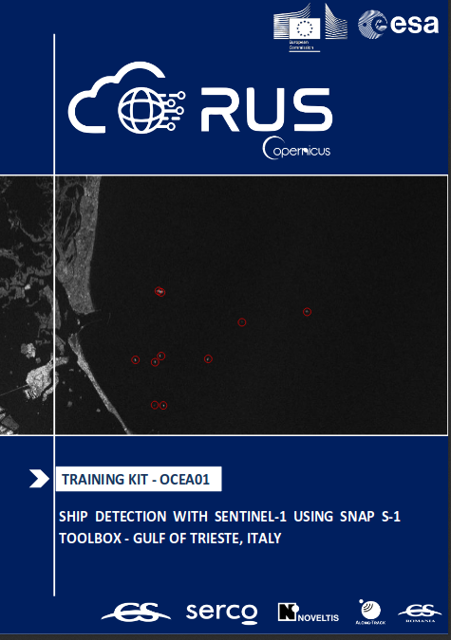
Ship detection with SAR images
RUS Tutorial :
”OCEA01. Ship detection with Sentinel-1
using SNAP S-1 toolbox….”
https://rus-copernicus.eu/portal/wp-content/uploads/library/education/training/OCEA01_ShipDetection_Trieste_Tutorial.pdf
Webinar: https://rus-copernicus.eu/portal/rus-webinar-ship-detection/
Data file (Sentinel-1): S1A_IW_GRDH_1SDV_20170810T024714_20170810T024738_017855_01DEF7_F48C
https://yadi.sk/d/8yNMs1-tuREyUg
Further reading:
Khalid El-Darymli…, Target detection in synthetic aperture radar imagery: a state-of-the-art survey (in Journal of Applied Remote Sensing on 4/12/2018)

